Slide 1


MATLAB & Simulink workshop
Made by: Youssef Ahmed

Slide 2

Session 4
Data Visualization

Slide 3

Last session recap

Slide 4

Part 1: MATLAB tips & tricks

Slide 5
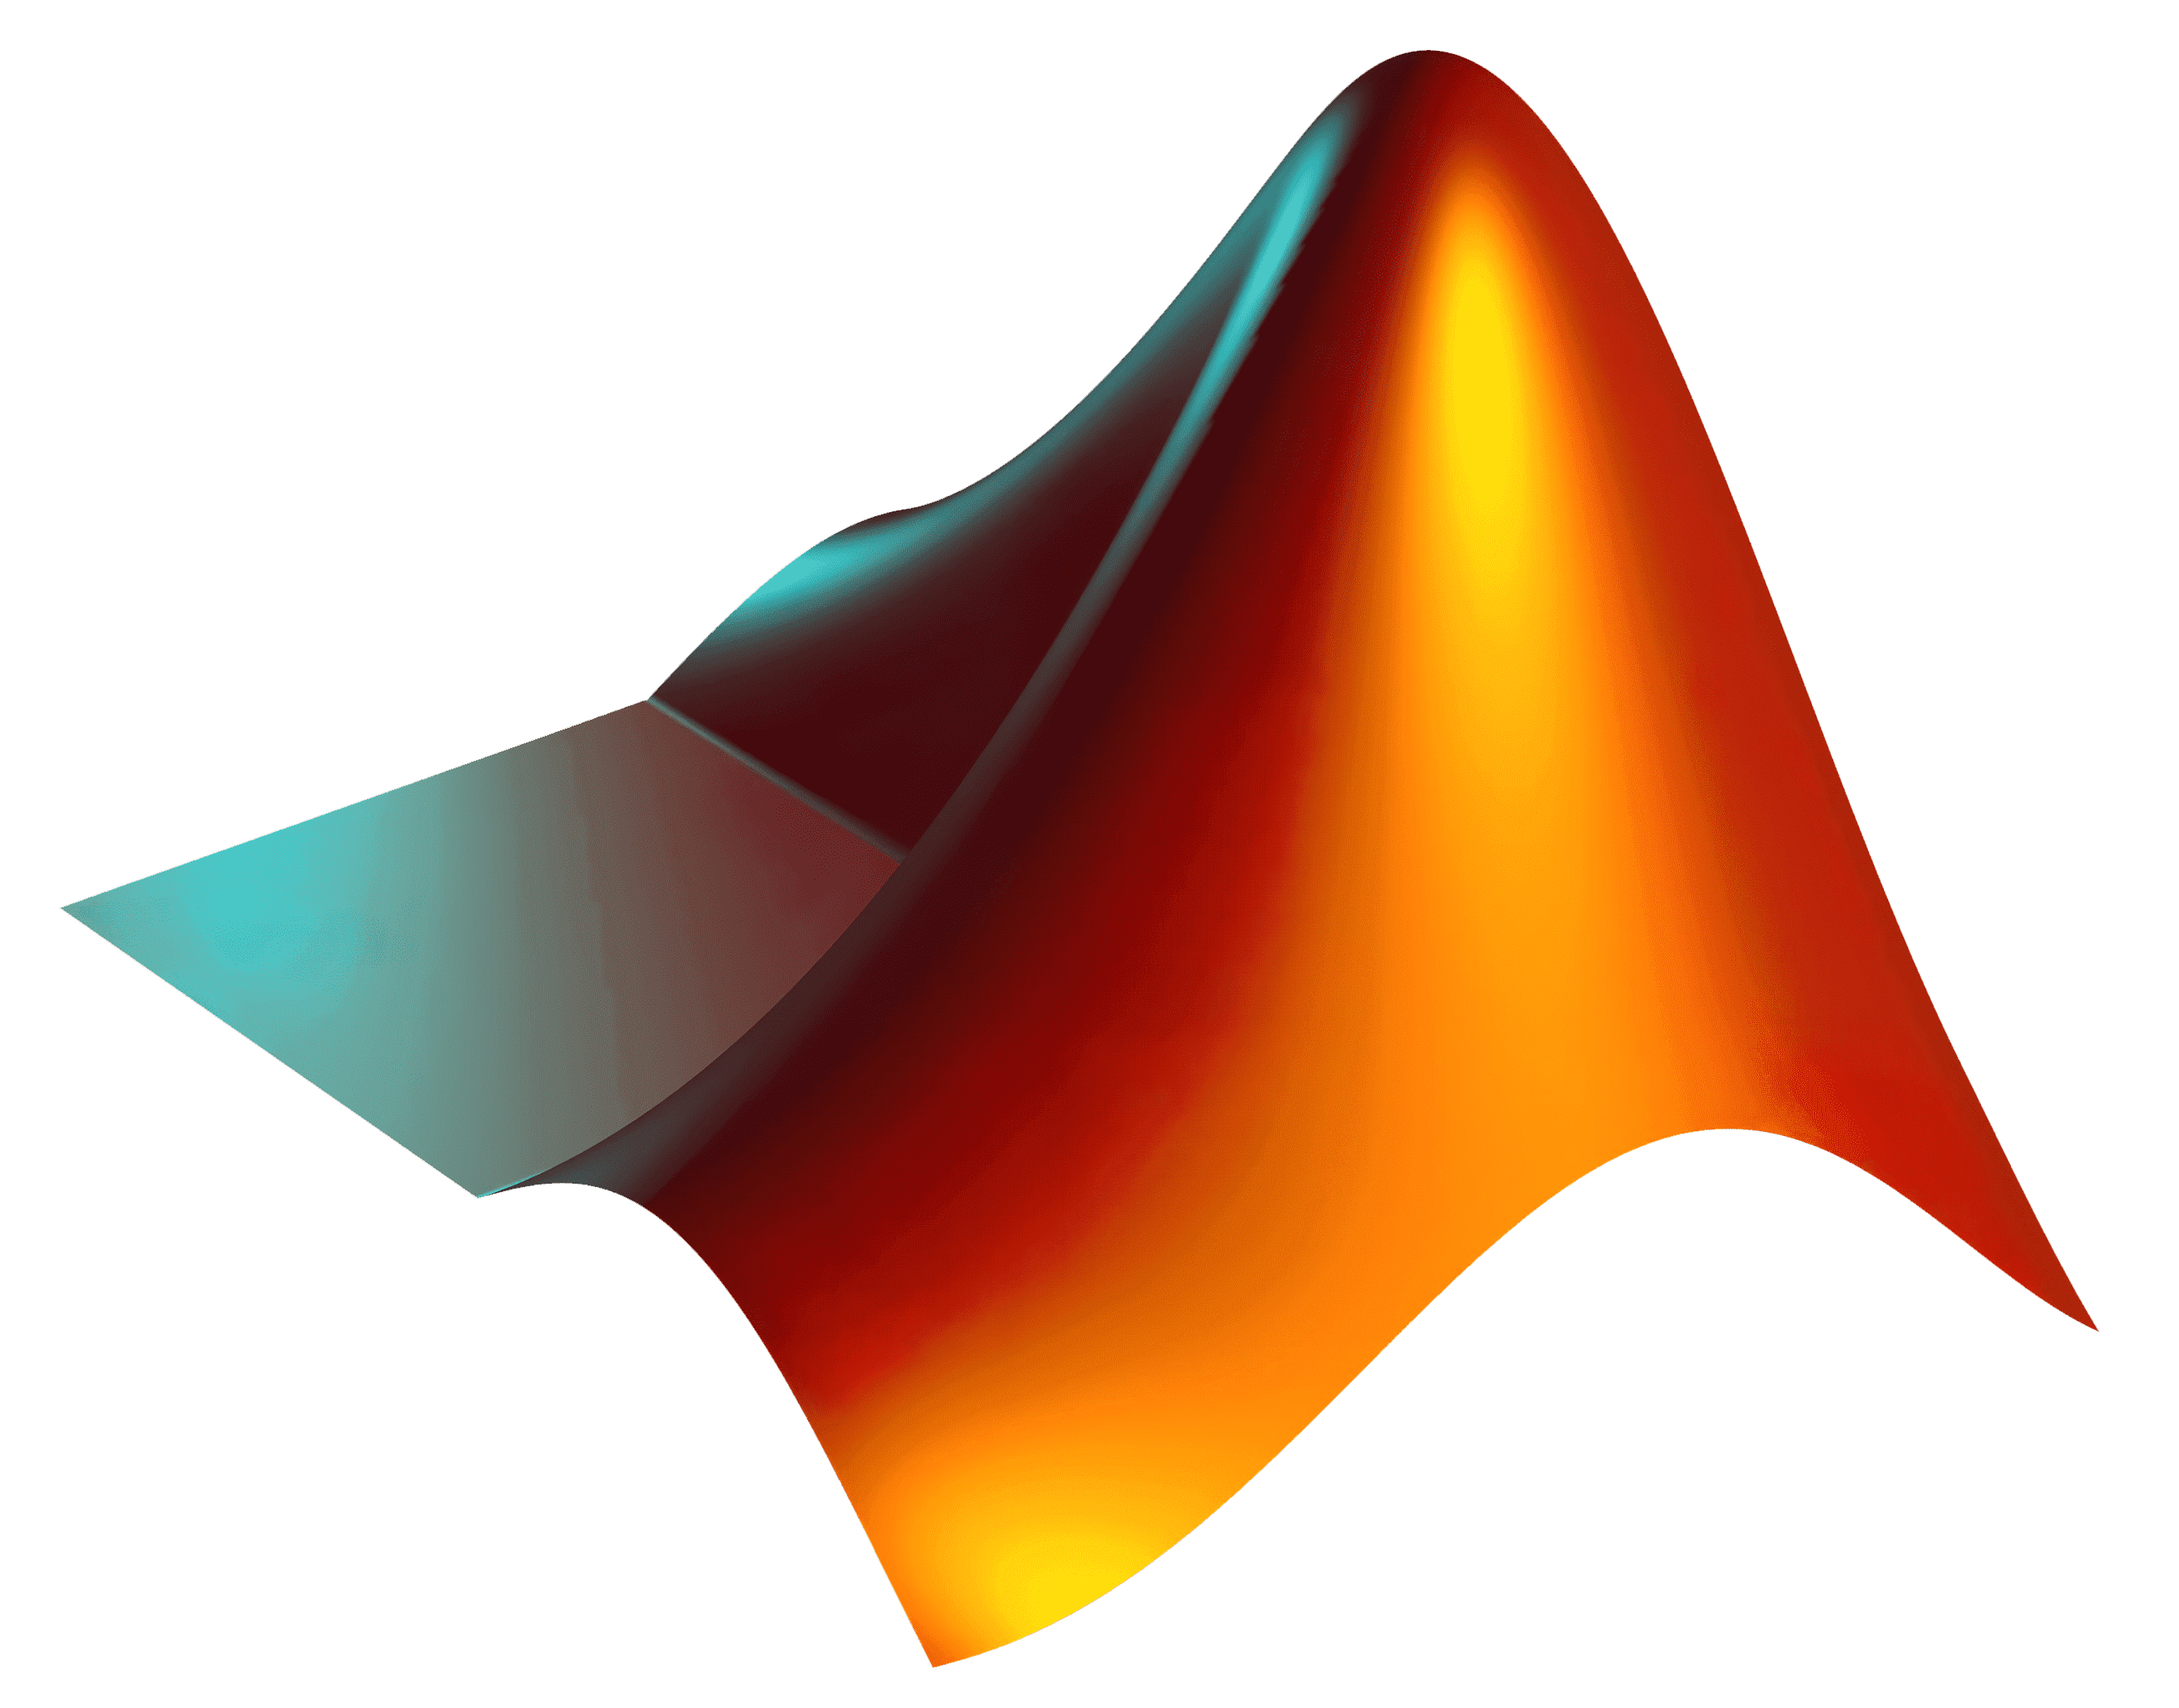
MATLAB time!
Now let’s see them live in MATLAB

Slide 6

Part 2: Data visualization

Slide 7
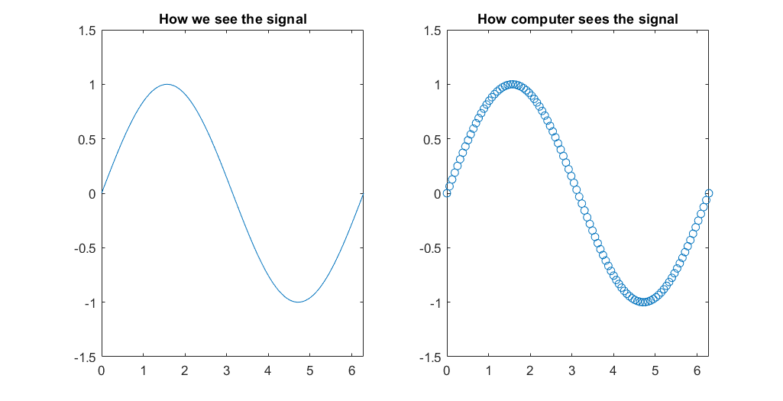
2D-Plotting
How can we get a plot on a computer ?
Computer works on discrete domain, our world is continuous domain

Slide 8
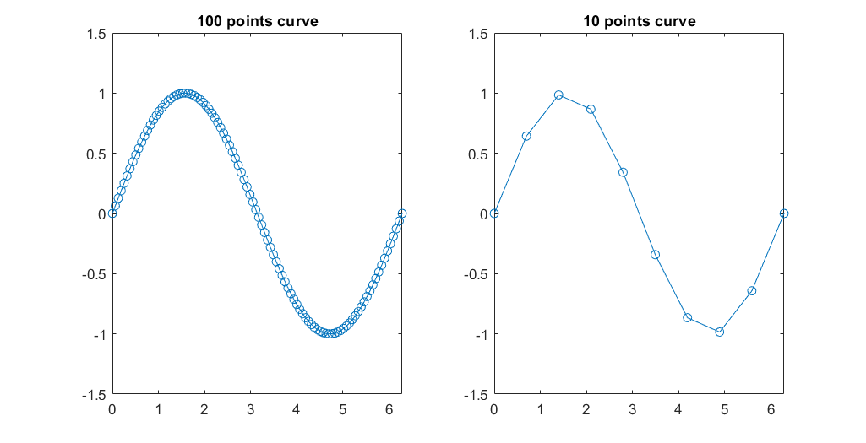
2D-Plotting
Resolution concept
The more point the signal has the more accurate it is to plot

Slide 9
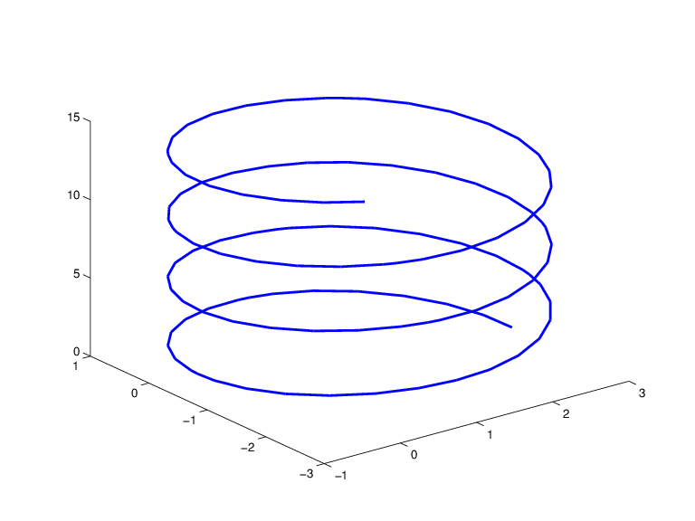
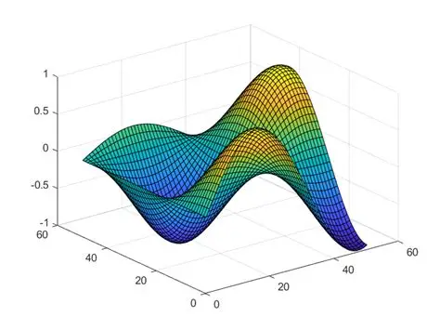
3D-Plotting
Types of 3D-plots
The 3D plot can change depending on the number of independent variables

Slide 10
Animation
Animation concept

Slide 11
MATLAB time!
Now let’s see what we covered so far in MATLAB

Slide 12
Task
You are required to submit one script (.m file) with the solution of the following problem (Comment your code with your own language is a must)
animateFunction()
1-Overview You are tasked with implementing a MATLAB function that generates an animated plot of mathematical functions and saves it as a video file.
The user specifies whether the animation should be 2D or 3D using a string input (‘2d’ or ‘3d’).
The function should automatically determine the exact plot type (2D curve, 3D curve, or 3D surface) based on the number and type of the provided function handles.
The animation should gradually reveal the curve or surface, and the video should be saved under the user-specified name.

Slide 13
Task
2-Inputs The function should have the following form: animateFunction(plotType, resolution, videoName, func1, varargin)
Where:
plotType (string): ‘2d’ or ‘3d’
Function handles: One or more MATLAB function handles representing the mathematical functions to plot
Hint: You can check if a variable (x for example) is a function handler using:
isa(x, 'function_handle’)
Resolution: Number of points used to sample the function(s)
Video name (string): Name of the output video file.
Optional axis-limit vectors: 0, 1, or 3 vectors specifying axis limits:
0 vectors → all axes default to [0, 4*pi]
1 vector → same limits apply to all axes
3 vectors → applied individually to x, y, and z axes

Slide 14
Task
3-Scenarios Depending on Inputs
2D Mode (plotType = ‘2d’):
One function handle: Plot y = f(t) vs t
Two function handles: Plot a 2D curve: the first function defines the x-axis, the second defines the y-axis.
3D Mode (plotType = ‘3d’)
Single function handle with two inputs: Create a 3D surface z = f(x, y) you can use meshgrid() to evaluate the domain (independent variables)
Two or three single-input function handles: Create a 3D curve
Two functions → (x, y, z) = (t, f1(t), f2(t))
Three functions → (x, y, z) = (f1(t), f2(t), f3(t))

Slide 15
Task
4-Test Cases
Use the following test cases to test your function
animateFunction("2d", 300, "sin Curve", @(t) sin(t));
animateFunction("2d", 300, « random Curve", @(t) t.^2, @(t) sin(t));
animateFunction("3d", 100, "paraboloid", @(x,y) x.^2 + y.^2);

Slide 16
Thank you!

